Slide 1

IPL team
for
World Peace Cricket league
By Hari Iyer INSAID
March 2019 Cohort

Slide 2
indian premier league
A professional T20 league, started in 2008 by BCCI that happens every Year in India, in the months of April and May.
A tournament that aims to promote Cricket in India and to provide a platform for the local players to play at a much higher level, to get the best possible environment for nurturing themselves into professionals and to provide enormous entertainment to the Cricket Fans in India and all over the world..
It's the most watched Cricket League in the world and, every season contributes about ₹5–10 bn to GDP of Indian Economy.

Slide 3
World Peace Cricket league
Just like IPL, there are many other Premier Leagues in the world . For example : England , Pakistan , Bangladesh , Afghanistan etc.
I want to create an Universal Premier League Cricket Cup for World Peace . The idea is to motivate world peace by creating teams across world . Each team will consist of members mixed from many different countries .

Slide 4
Ipl data
Data source :
https://github.com/insaid2018/Term-1/blob/master/Data/Projects/matches.csv
https://github.com/insaid2018/Term-1/blob/master/Data/Projects/deliveries.csv
https://raw.githubusercontent.com/insaid2018/Term-1/master/Data/Projects/matches.csv
https://raw.githubusercontent.com/insaid2018/Term-1/master/Data/Projects/deliveries.csv
The dataset contains 2 files: deliveries.csv and matches.csv.
matches.csv contains details related to the match such as location, contesting teams, umpires, results, etc.
deliveries.csv is the ball-by-ball data of all the IPL matches including data of the batting team, batsman, bowler, non-striker, runs scored, etc.

Slide 5
Team IPL : World Peace Cricket league
Problem statement :
For this world cup , I want to select the 15 membered squad of team IPL consisting of the best multinational players from the IPL teams who played IPL matches from 2008 till 2018.

Slide 6
Exploratory data Analysis
What did I do to Achieve the end result?
I made use of Domain Knowledge where ever applicable.
Used Pre profiling to deeply understand each column
Dropped duplicate rows in deliveries_data and ‘umpire3’ column of matches_data due to 91.4% missing values
Post profiled processed data
Processed the data using seaborn and matplotlib to select top 10 from the most relevant columns of the given data sets

Slide 7
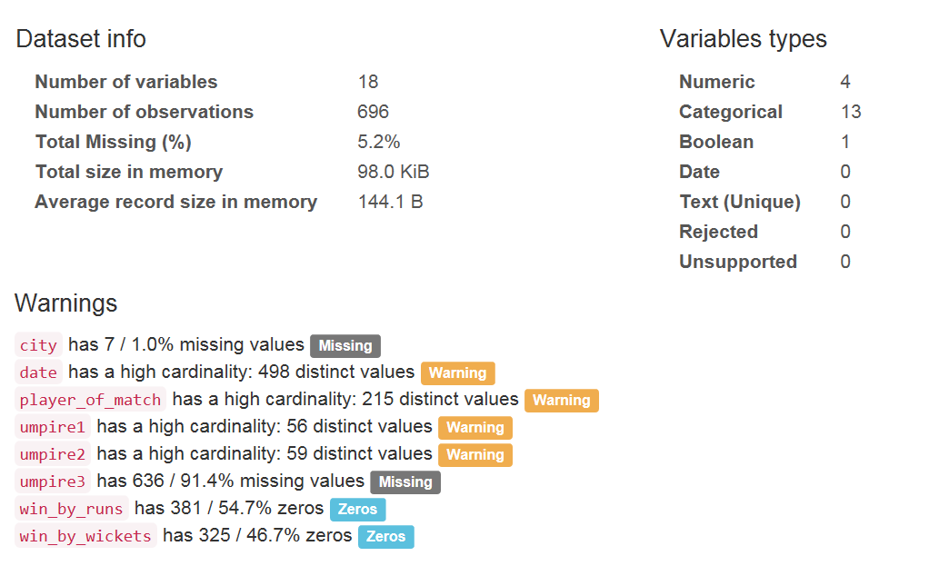
Pre Profile
matches_data_before_preprocessing.html
** Umpire3 has 91.4% missing values

Slide 8
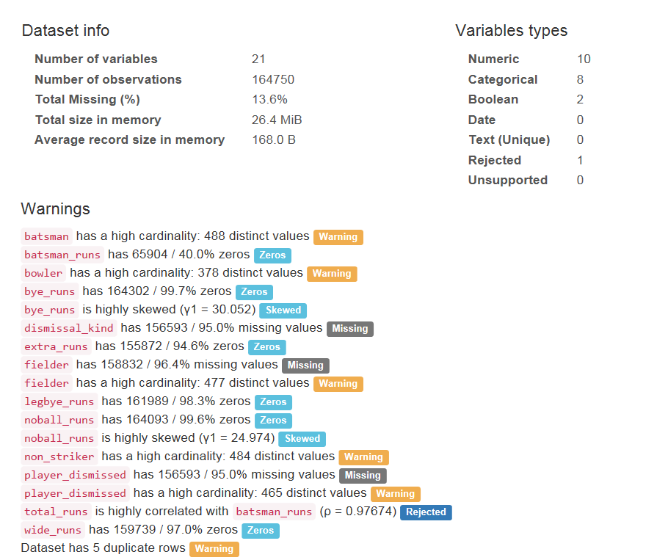
Pre Profile
deliveries_data_before_preprocessing.html
** Dataset has 5 duplicate rows

Slide 9
Preprocess
Dropped duplicate rows in deliveries_data
Dropped ‘umpire3’ column of matches_data due to 91.4% missing values
Did not disturb total_runs although batsman_runs is highly co-related with it because this is expected behavior as per domain knowledge.

Slide 10
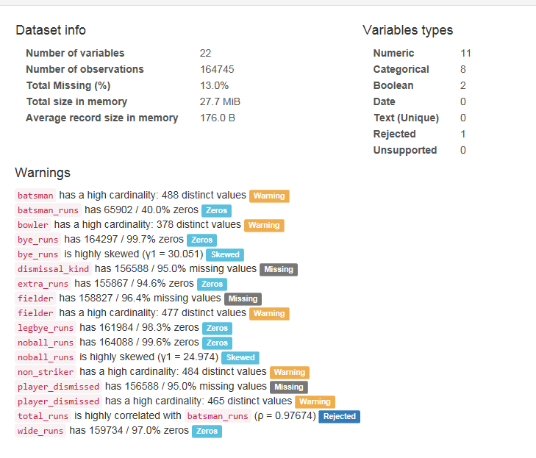
Post Profile
deliveries_data_after_preprocessing.html

Slide 11
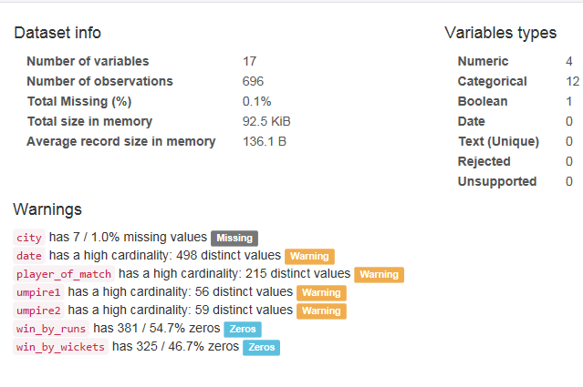
Post Profile
matches_data_after_preprocessing.html

Slide 12
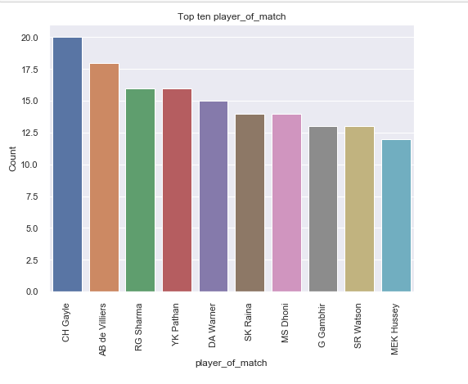
Top players of the matches
CH Gayle, AB Devillers, RG Sharma and YK Pathan shortlisted

Slide 13
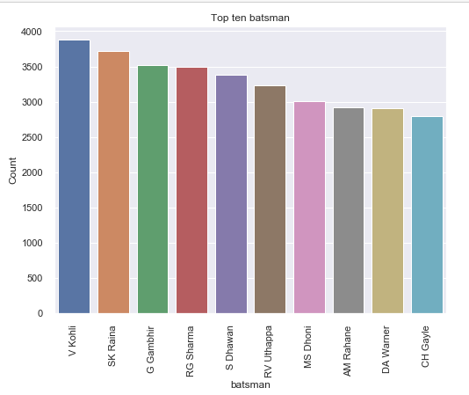
Top experienced batsmen
V Kohli, SK Raina, GGambhir and RG Sharma shortlisted

Slide 14
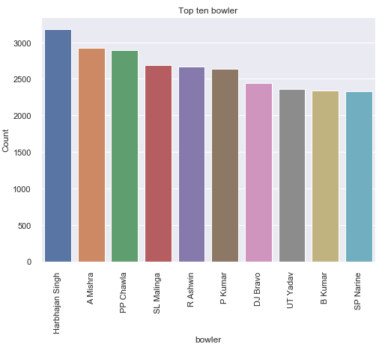
Top experienced bowlers
Harbhajan Singh, A Mishra, PP Chawla , SL Malinga and R Ashwin shortlisted

Slide 15
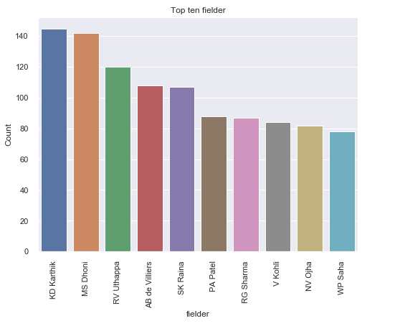
Top experienced fielders
KD Karthik , MS Dhoni , RV Uthappa and AB deVilliers shortlisted

Slide 16
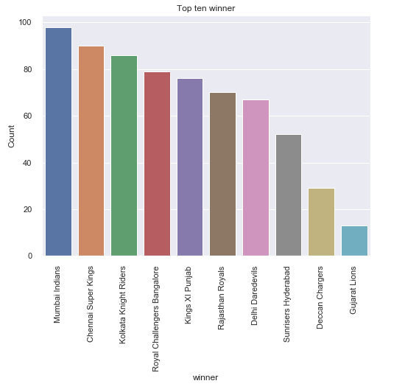
Top
Winning teams
RG Sharma selected as Captain : MS Dhoni selected as Vice captain

Slide 17
Selected team ipl for World Peace Cricket league
The selected team is a 15 member squad consisting of top performing international players of match , batsmen, bowlers ,fielders, most successful captains from multiple countries from the IPL matches played between years 2008 and 2018.
AB de Villiers
A Mishra
SL Malinga
KD Karthik
V Kohli
MS Dhoni( Vice Captain)
CH Gayle
RV Uthappa
R Ashwin
SK Raina
YK Pathan
G Gambhir
RG Sharma ( Captain)
Harbhajan Singh
PP Chawla
Wishing "All the best" to team IPL for the Universal Premier League Cricket Cup for World Peace.

Slide 18
THANKYOU

